Slide 1
Generic and Specialized Word Embeddings for Multi-domain Machine Translation
MinhQuang Pham†‡, Josep Crego†, Jean Senellart† and François Yvon‡
†SYSTRAN / 5 rue Feydeau, 75002 Paris, France
‡LIMSI-CNRS, Université Paris-Saclay 91405 Orsay, France

Slide 2
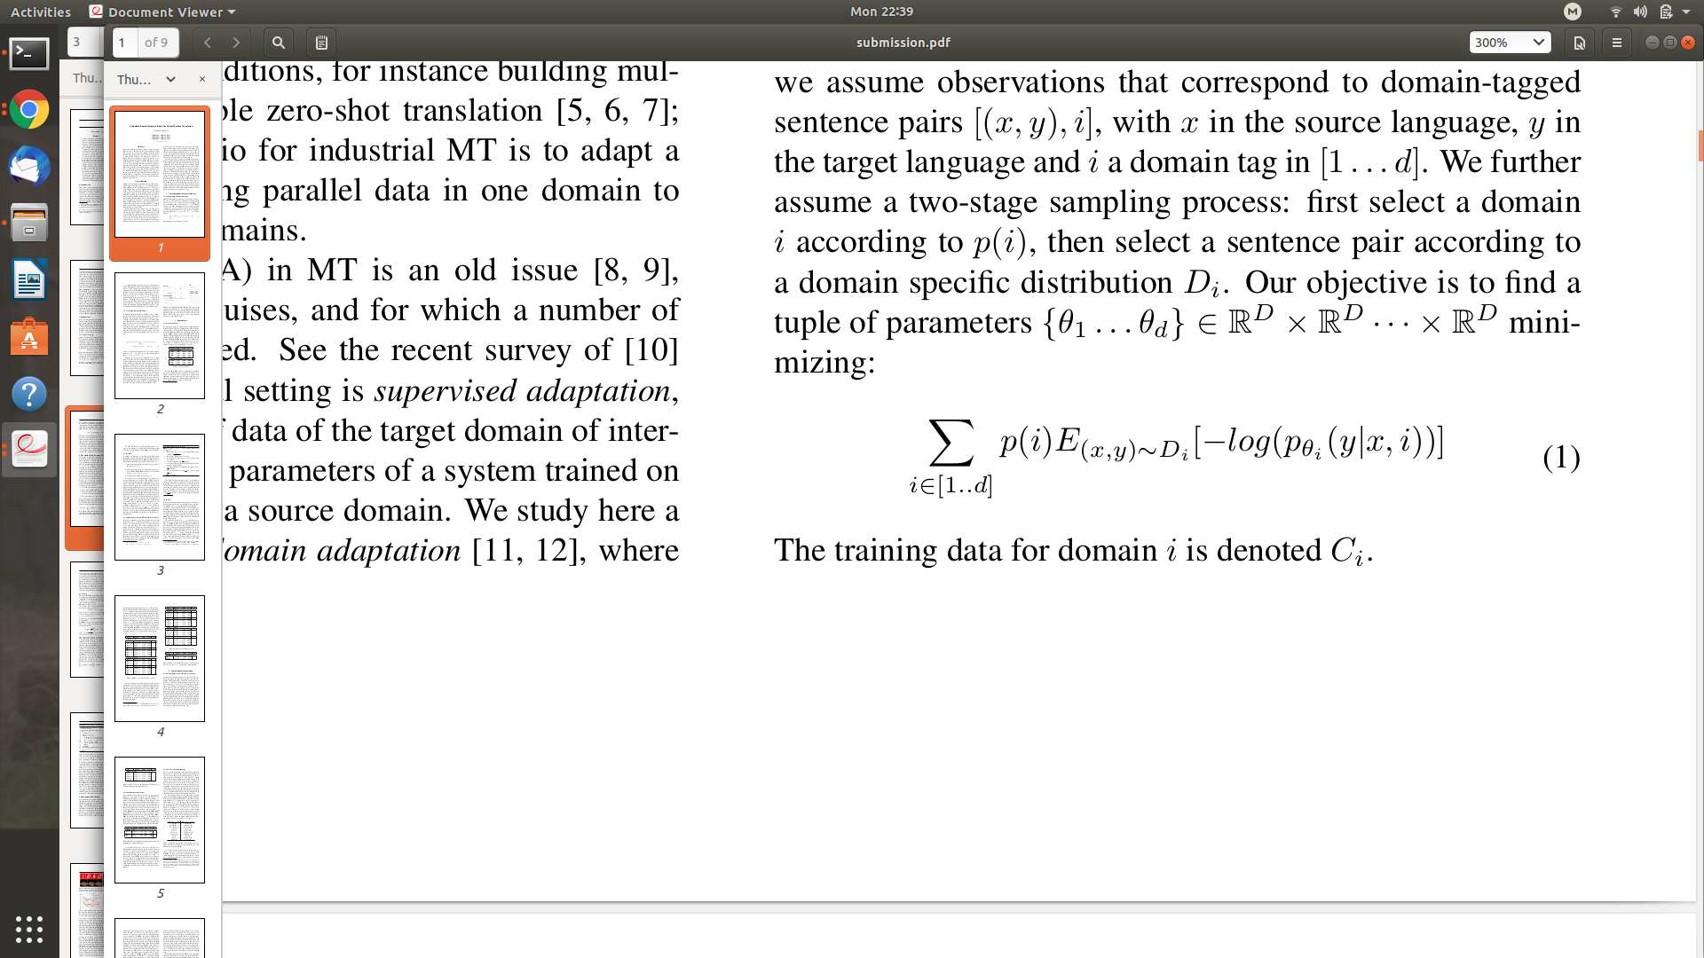
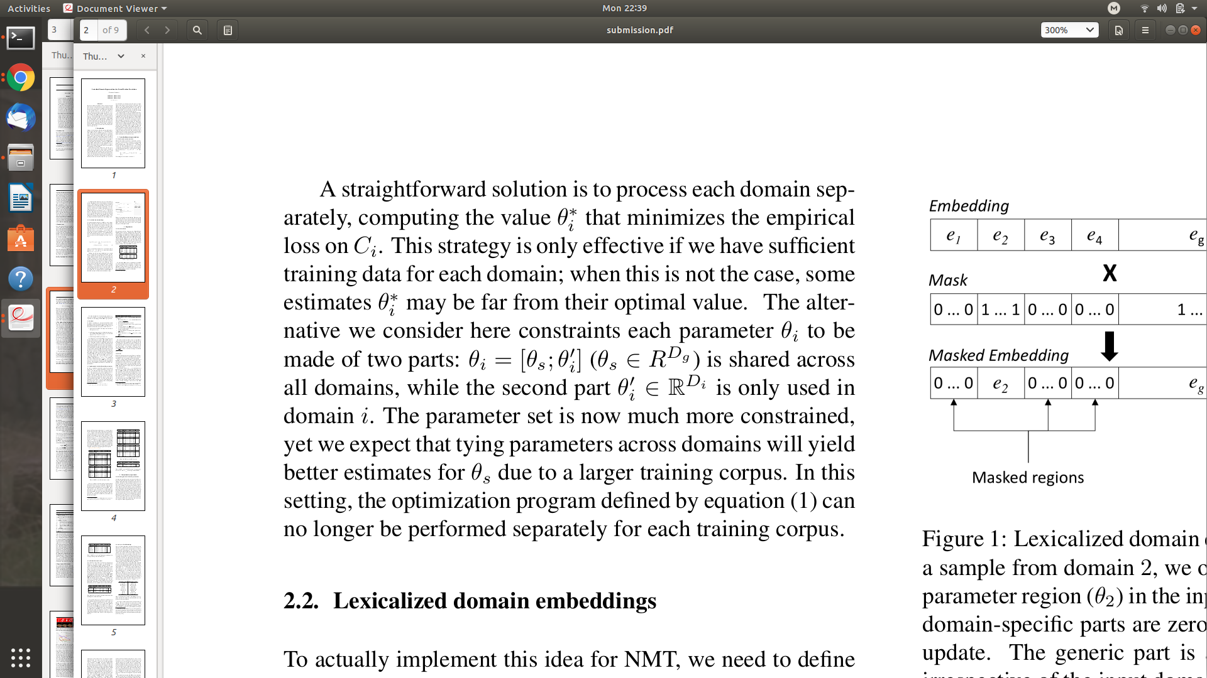
Multi-domain machine translation
General context:
Multiple in-domain training data sets
Multiple in-domain test sets
Multi-domain objective
High performance in all in-domain test sets.
Loss function:
Sharing parameters:

Slide 3
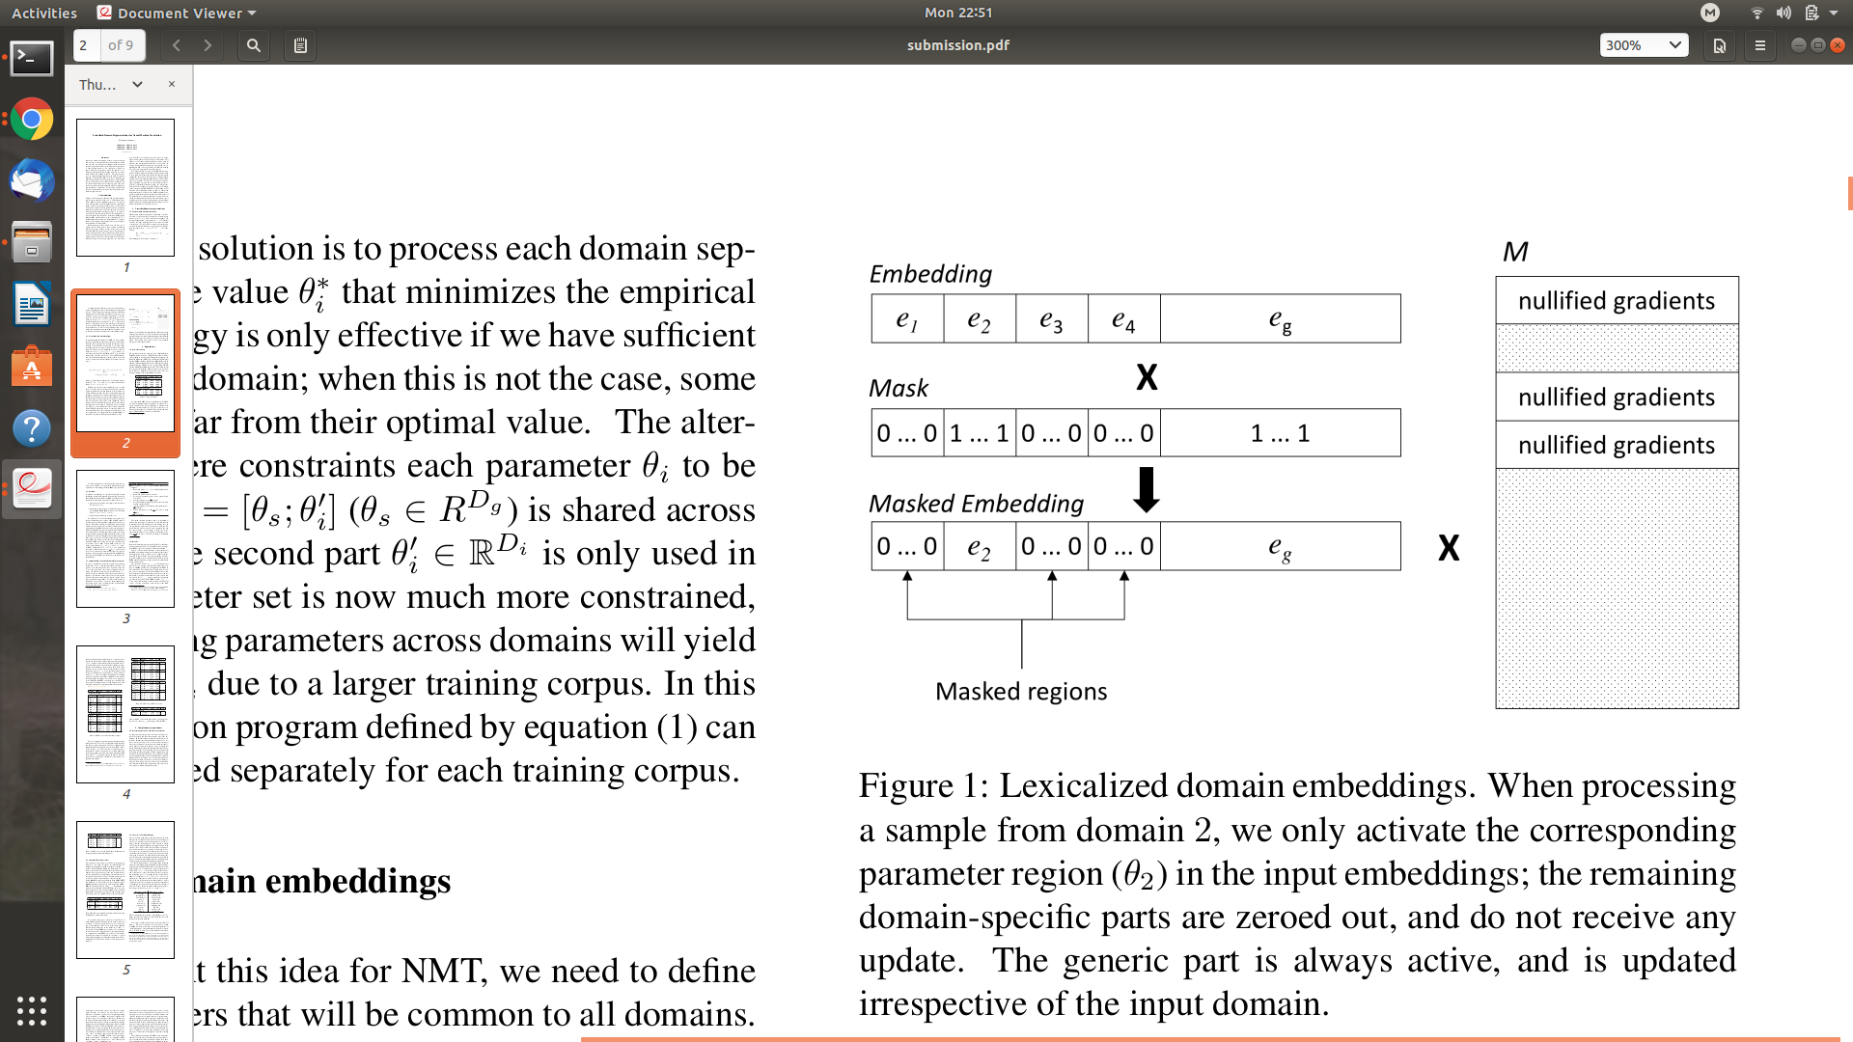
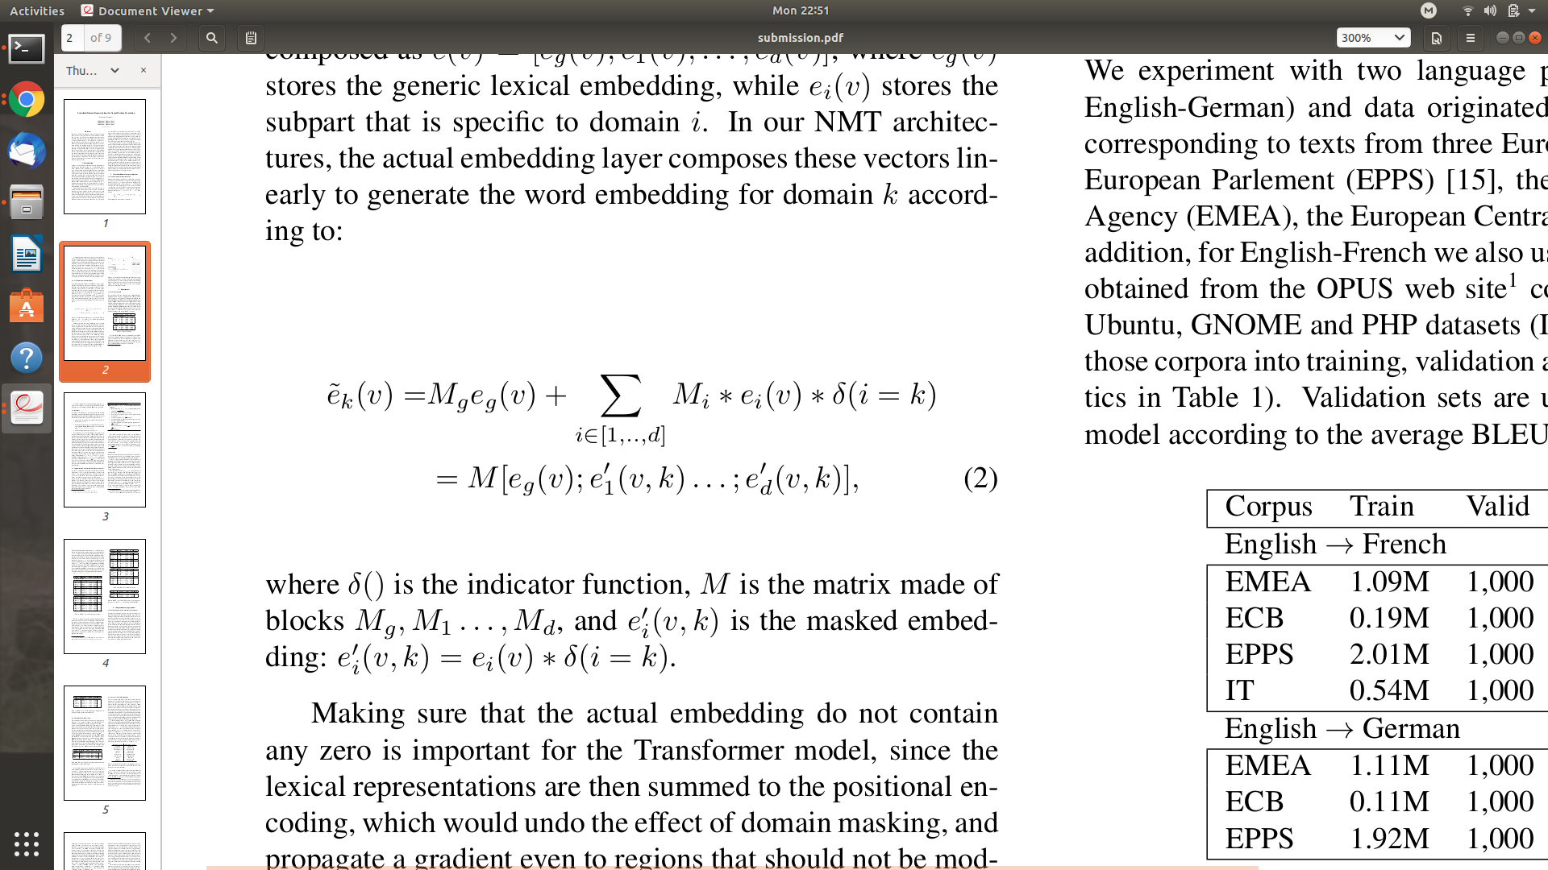
Generic and Specialized Word Embedding

Slide 4
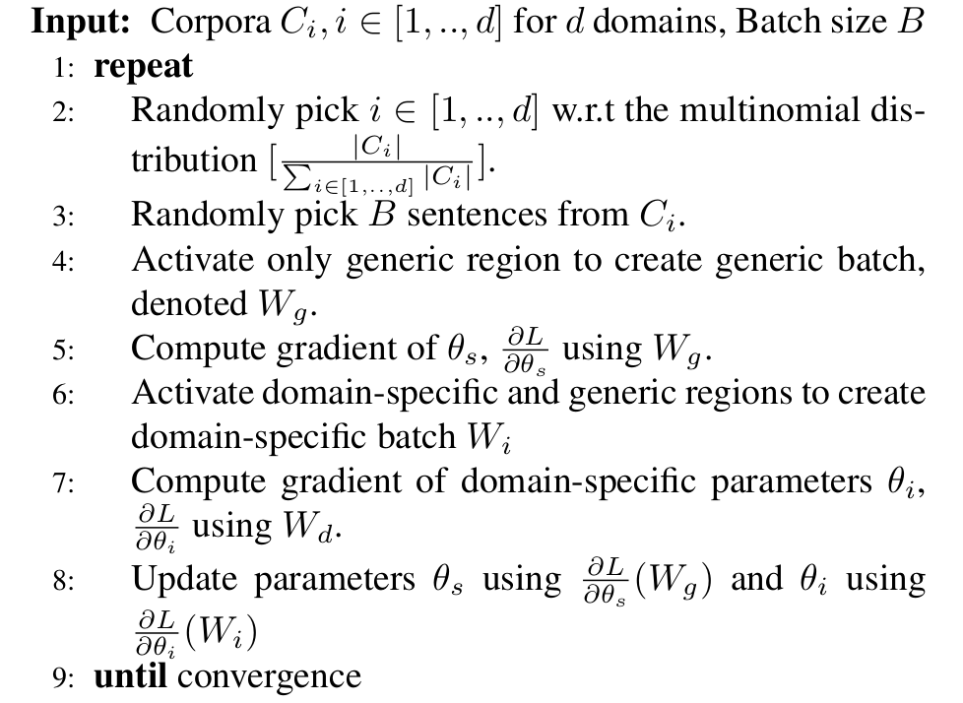
Training Algorithm

Slide 5
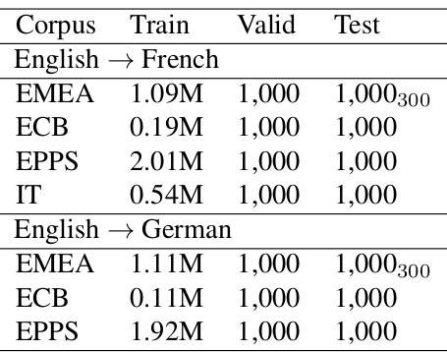
Experiments
Data
3 in-domain corpora
ECB, EMEA, EPPS
2 translation tasks
En-De, En-Fr
Evaluation settings:
Random splits: Train/Dev/Test ( */ 1k/ 1k)
Baselines:
All data training.
Fine-tuning by continue training with in-domain corpora.
Domain control features (C. Kobus et al).
WDCMT (J. Zeng et al)

Slide 6
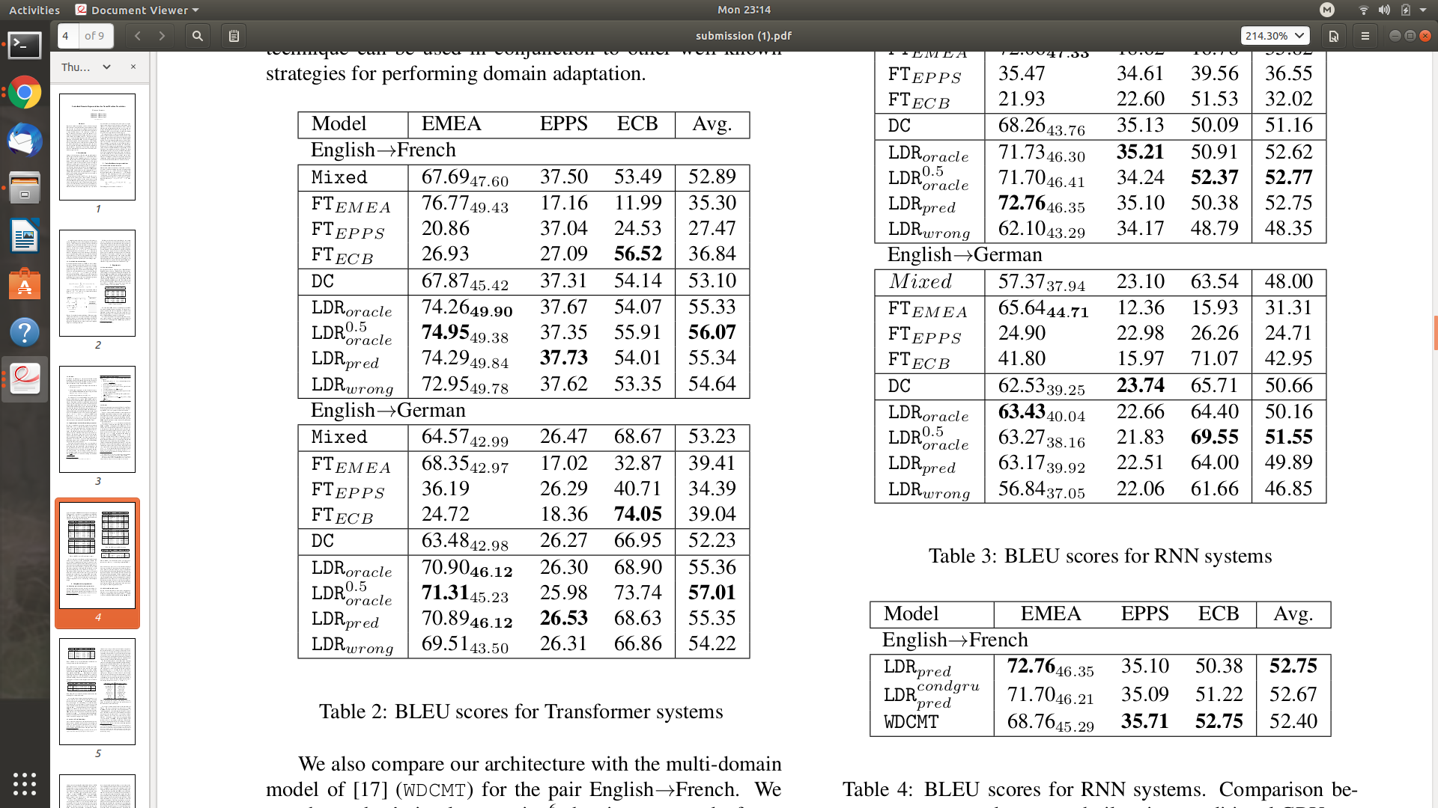
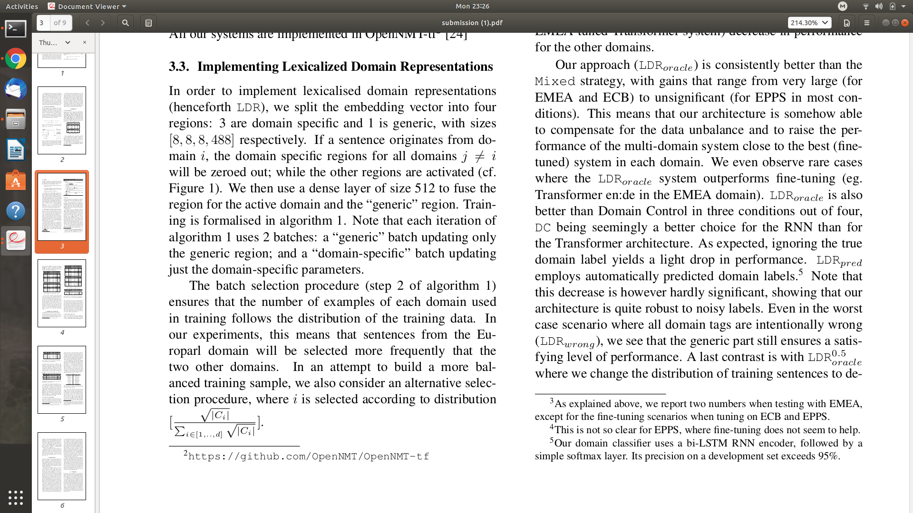
In-domain tests
Notations:
pred : using domain label predicted by a pretrained domain classifier.
wrong: using random domain label.
oracle: using domain-label of in-domain corpora from which the test sets were splitted.
oracle^{0.5}: training with data proportion
FT: fine-tuned by continuing training with in-domain corpora
DC: Domain Control

Slide 7
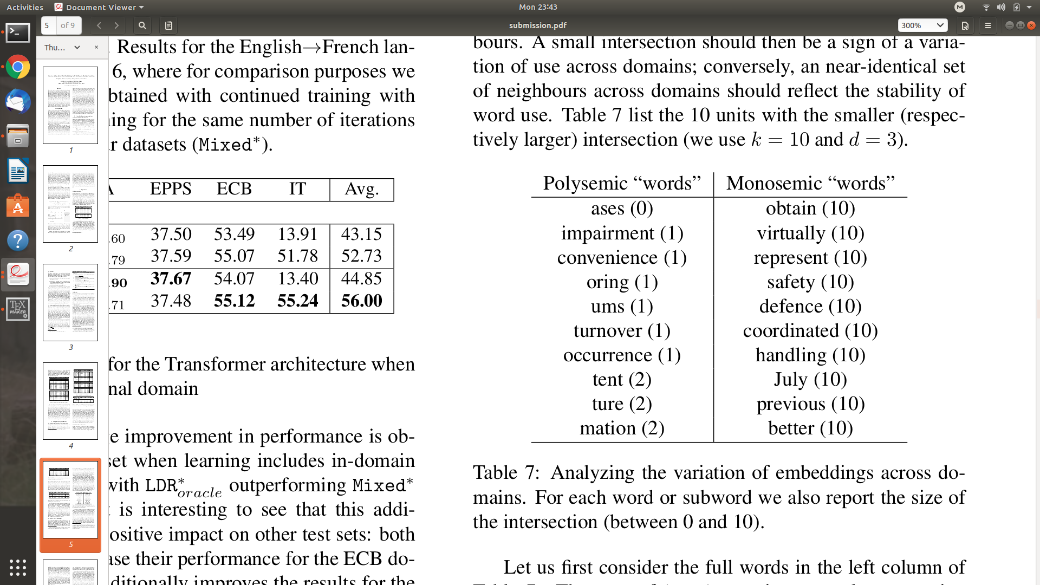
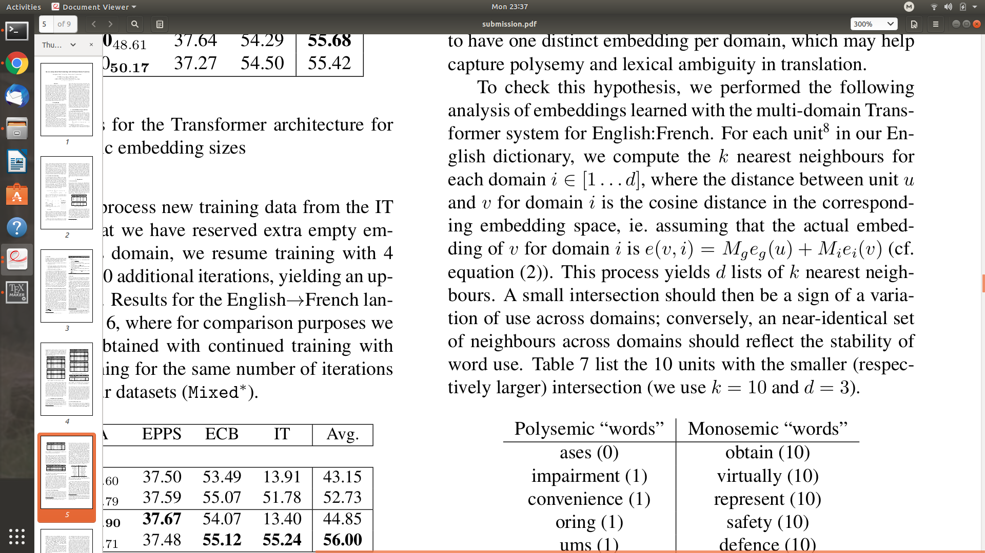
In-domain Word Embeddings
One Word Embeddings per domain
The in-domain k-nearest neighborhoods difference and polysemies:
Intersection of 10-nearest neighborhoods of token in each domain space

Slide 8
Conclusion
Contributions:
A simple feature based approach for Multi-domain NMT.
New initiative to discover polysemies.
Future work:
Self-configurable model:
Adapting size of the domain-specific regions depending upon the actual variation of use across domains.
Integrating arbitrary number of new domains in dynamic fashion.

